Slide 1
Stem Cells
Divide indefinitely
Can be cloned in a laboratory – therapeutic cloning
Using chemical signals can be transformed into specialised cells (such as muscle, liver, nerve)
Adult stem cells
Embryonic stem cells

Slide 2
Adult Stem Cells
Taken from adults, children, babies and foetuses
Cells are multipotent
In current use: bone marrow transplants (or from umbilical cord) to treat blood disorders such as leukaemia and anaemia

Slide 3
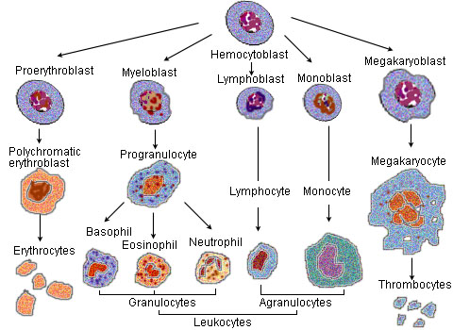

Slide 4
Embryonic Stem Cells
From 3-7 day old embryos (often called pre-embryos) discarded from IVF treatment
Cells are totipotent or pluripotent
Some experimental use, mainly theoretical
May be used in the future to treat diabetes, Parkinson’s disease and Alzheimer’s disease

Slide 5
Cloning
Therapeutic cloning is the process of cloning (growing exact copies) of a stem cell
Reproductive cloning attempts to create an exact copy of an already living animal (such as ‘Dolly’ the sheep)
Legislation has been passed to ban to reproductive cloning of humans

Slide 6
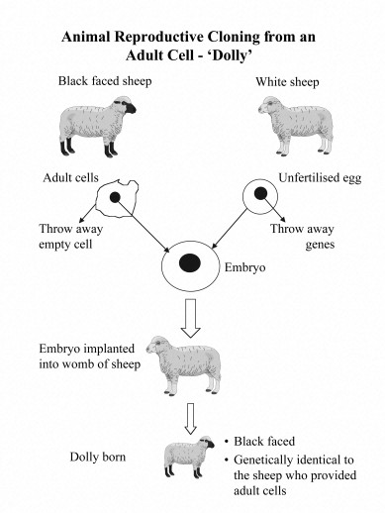
Reproductive cloning involves a process called somatic cell nuclear transfer

